Slide 1
Internet Association of Fintech Services
for online product company

Slide 2
Our partners
Online casino
Traders clubs
Dating sites
Payment system providers
Online services

Slide 3
Common problems
Chargebacks
Deception by unscrupulous intermediaries
Hundreds of thousands of lost dollars

Slide 4
Data protection
data is transmitted only in encrypted form
only system participants can check data
c73979a15e30f2c1cce0ec24ac37cb7c62a075045e324fa7cc6e9f1693ac1ba9
25540aa27ceb9d0e1f1571c5280045d7ef5001b37804be8bafadaca9942ec55a
401b2ffec20a4629cfa5be431bfc073be570bda9adfb6a058d8b7b15a38b417f

Slide 5
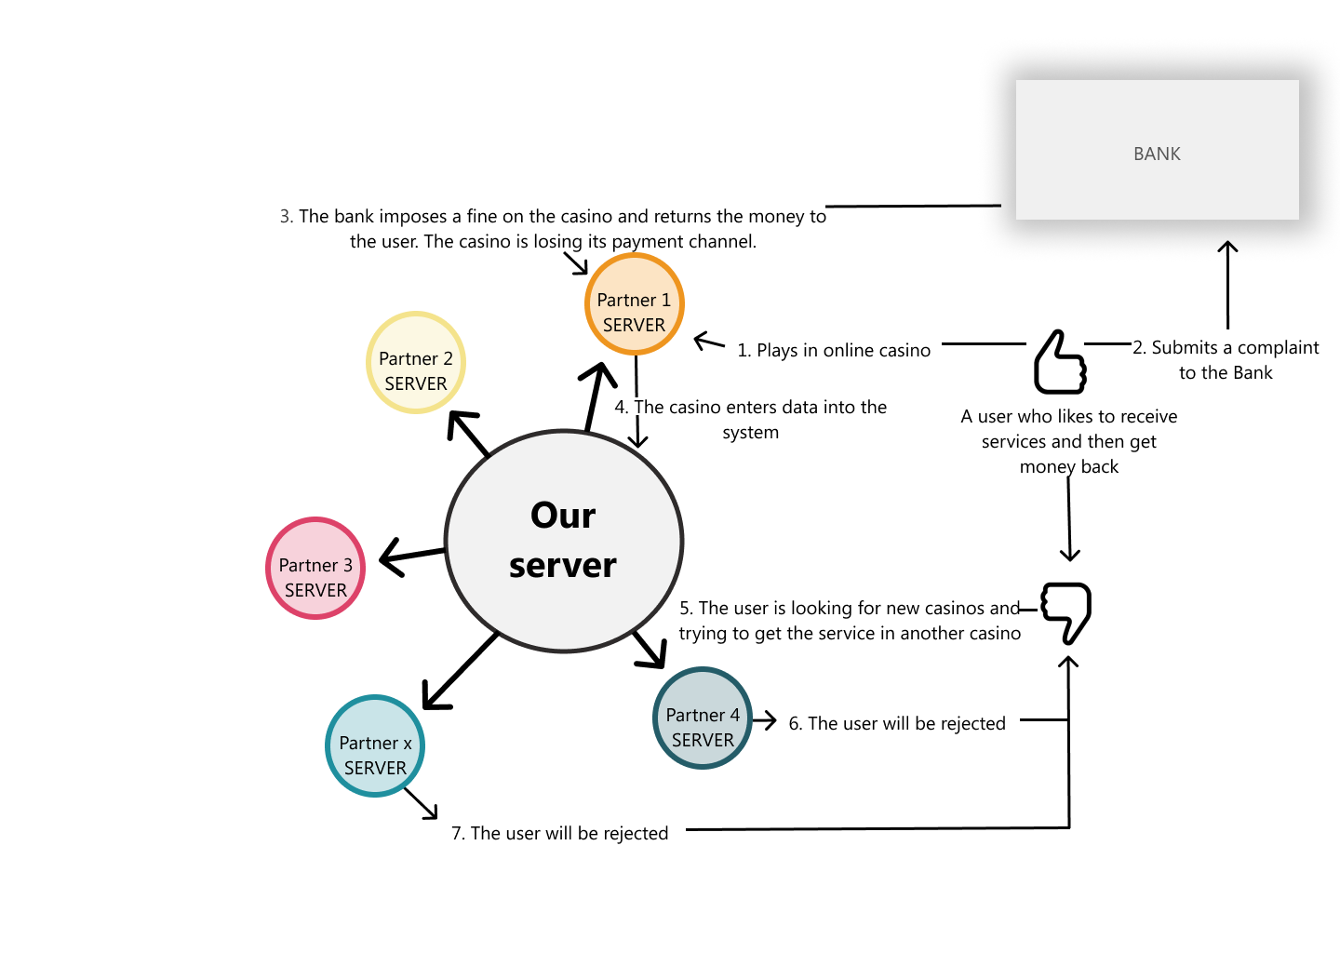
How it works

Slide 6
join us
https://iafs.info
administrator@iafs.info

